Slide 1


Subtitle Generator Pro: An Overview
Author: Abdul Hannan 23-NTU-CS-1002
Author: Arslan Ali 23-NTU-CS-1019
Author: Hassan Ali 23-NTU-CS-1036
Date: 2025-06-06

Slide 2

CONTENTS
1. Introduction
2. Core Technologies and Libraries
3. Application Structure
4. Whisper Model Integration
5. Subtitle Generation Workflow
6. User Interface and Experience
7. Future Enhancements

Slide 3

01
Introduction

Slide 4

Introduction
This application, "Subtitle Generator Pro," is a desktop tool built with customtkinter that leverages OpenAI's Whisper model for speech-to-text transcription and Google Translate for language translation.
It's designed to help users generate and eventually embed subtitles for their video files.

Slide 5

02
Core Technologies and Libraries

Slide 6







Core Technologies and Libraries
customtkinter
whisper
googletrans
Provides a modern, customizable GUI experience.
OpenAI's robust speech-to-text model, used for transcribing audio from videos.
A free and unlimited Python library that implements the Google Translate API, used for translating transcribed text.
ffmpeg
threading
tempfile and shutil
(via subprocess): Although not fully implemented for embedding in the provided code, this is the intended tool for hardcoding subtitles onto video files.
Ensures the UI remains responsive during long-running tasks like model loading, transcription, and translation.
Used for managing temporary files and directories.

Slide 7

03
Application Structure

Slide 8

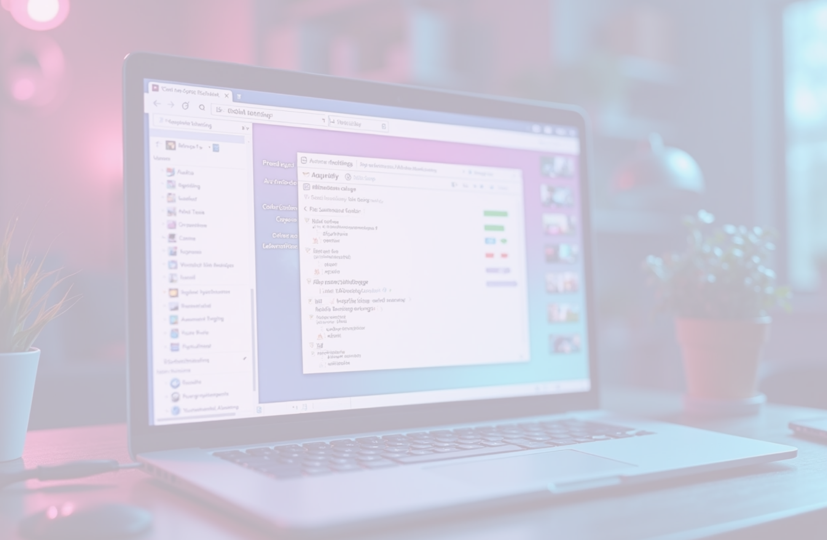
Application Structure
The application is structured into several classes, each responsible for a specific part of the user interface and its logic:
• SubtitleApp(ctk.CTk): The main application window. It manages:
• Global settings (like theme and color).
• Loading and managing the Whisper AI model.
• Navigation between different screens (frames).
• Cleanup of temporary files on exit.
• SplashScreen(ctk.CTkFrame): The initial screen displayed when the application starts, featuring an animated title.
• MainMenu(ctk.CTkFrame): The central hub of the application, offering options to proceed to subtitle generation or access global settings.
• SubtitlePage(ctk.CTkFrame): The core functionality page where users:
• Select video files.
• Choose transcription/translation options (original, English, Urdu).
• Select the Whisper AI model size.
• Monitor the subtitle generation process through a log and progress bar.
• Save generated SRT files.
• AnimatedLabel(ctk.CTkLabel): A custom widget for creating fade-in text animations, used in the Splash Screen.

Slide 9

04
Whisper Model Integration

Slide 10

Whisper Model Integration
The application integrates with the Whisper AI model for audio transcription and translation:
• Model Options: Users can select from various Whisper model sizes (tiny, base, small, medium), allowing for a trade-off between speed and accuracy.
• Dynamic Loading: Models are loaded dynamically based on user selection. A fallback to the tiny model is attempted if the initial load fails.
• Asynchronous Loading: Model loading is performed in a separate thread to prevent the UI from freezing.
• Transcription and Translation:
• The transcribe method of the loaded Whisper model is used to convert speech to text.
• For English translation, Whisper's built-in translation task is utilized.
• For Urdu translation, the googletrans library is employed to translate the English transcription.

Slide 11

05
Subtitle Generation Workflow

Slide 12


Subtitle Generation Workflow
The generate_subtitles method orchestrates the entire process:
• Video Selection: Users select a video file through a file dialog.
• Language and Model Selection: Users specify the desired output language (original, English, Urdu) and the Whisper AI model.
• Audio Extraction (Implicit): Whisper handles the audio extraction internally from the selected video.
• Transcription/Translation:
• Whisper transcribes the audio.
• If English translation is selected, Whisper performs the translation.
• If Urdu translation is selected, googletrans translates the transcribed text to Urdu.
• SRT File Creation: The transcribed/translated text segments, along with their timestamps, are formatted and saved as a temporary .srt (SubRip Subtitle) file.
• User Save Dialog: The application prompts the user to save the generated .srt file to a location of their choice.
• Subtitle Embedding (Future Work): The current code sets the stage for integrating ffmpeg to hardcode the generated subtitles into the video.

Slide 13

06
User Interface and Experience

Slide 14






User Interface and Experience
Intuitive Layout
Progress Tracking
Responsive Design
The UI is designed with clear labels, buttons, and input fields.
A progress bar and a log box provide real-time feedback on the subtitle generation process.
The use of threading ensures the UI remains responsive, preventing it from freezing during computationally intensive tasks.
Error Handling
Temporary File Management
Basic error logging is implemented to inform the user about issues during model loading or subtitle generation.
The application creates and cleans up temporary directories for intermediate files, ensuring a tidy system.

Slide 15

07
Future Enhancements

Slide 16


Future Enhancements
1
Subtitle Embedding
2
Advanced Settings
Full integration of ffmpeg to directly hardcode subtitles onto video files.
More granular control over subtitle style (font, size, color) and position.
3
Multiple Translation Engines
4
Batch Processing
Support for other translation APIs for improved language coverage or quality.
Ability to process multiple video files simultaneously.
5
Customizable Output Formats
Options to export subtitles in different formats (e.g., VTT, ASS).

Slide 17

Thank You

